Slide 1
Conversations that Matter COVID - Flu
Pam Farber
Mike Taigman
Silvia R. Verdugo

Slide 2
Outline
History of Influenza
Symptoms Flu vs COVID
Recommendations for EMS in regards to Flu
COVID & Flu Vaccine

Slide 3
History of Influenza

Slide 4
Weekly % Visits for Influenza Like Illness (ILI) 2009 to 2020
2019 – 2020: 65, 073, 444
2018 – 2019: 60, 856, 795
2017 – 2018: 48, 017, 974
https://www.cdc.gov/flu/weekly/index.htm

Slide 5
Laboratory Confirmed Influenza
2019-2020
45,921 /101,673
2018-2019
45,881 /91,592
https://www.cdc.gov/flu/weekly/index.htm

Slide 6
2019-2020
2017-2018
54,982 /106,671
https://www.cdc.gov/flu/weekly/index.htm

Slide 7
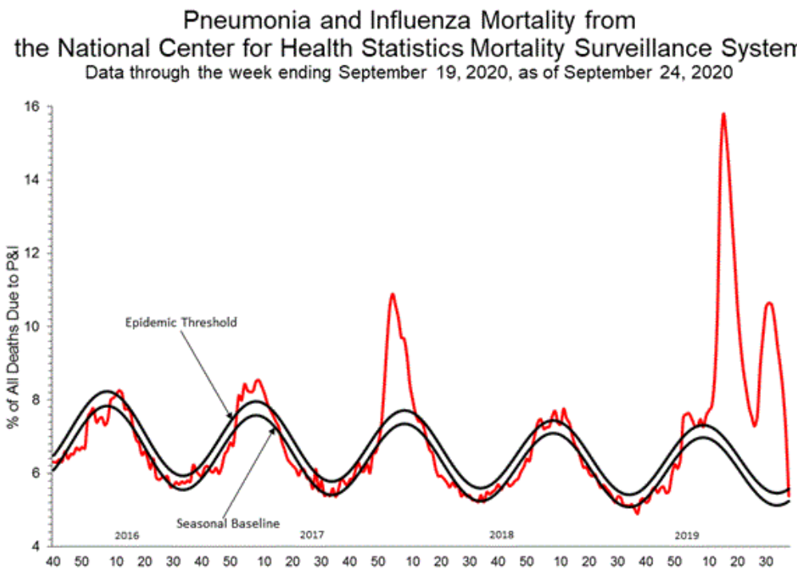
https://gis.cdc.gov/grasp/fluview/mortality.html

Slide 8
Symptoms Flu vs COVID

Slide 9
Clinical Criteria for Influenza Like Illness
WHO – ILI | CDC - ILI
Acute Respiratory Illness | Fever (100°F/37.8°C or >)
and | and
Temperature ≥ 38 °C | Cough
and | and/or
Cough | Sore throat
* Onset last 10 days | *Respiratory Illness - symptoms without know cause

Slide 10
CDC – COVID - 19
Option A:
Option B:
Option C:
At least 2 of the symptoms:
Fever
Chills
Rigors
Myalgia
Headache
Sore throat
Nausea or vomiting
Diarrhea
Fatigue
Congestion or runny nose
At least 1 of the symptoms:
Cough
Shortness of breath
Difficulty breathing
New olfactory disorder
New taste disorder
Severe respiratory illness + 1:
Pneumonia
Acute respiratory distress syndrome

Slide 11
WHO – Suspected COVID - 19
Option A:
Option B:
1. Acute onset of fever + cough
or
2. Acute onset of 3 or >:
Severe Acute Respiratory Illness:
1. Acute Respiratory Infection
and
2. Fever
and
3. Cough
and
4. Onset last 10 days
and
5. Hospitalization
Fever | Sore throat
Cough | Coryza
Weakness | Dyspnea
Fatigue | Anorexia/nausea/vomit
Headache | Diarrhea
Myalgia | AMS
and
3. Epidemiological criteria

Slide 12
CDC - Influenza
WHO - Influenza
Fever
Cough
Acute Respiratory
WHO - COVID
CDC - COVID

Slide 13
https://www.cdc.gov/coronavirus/2019-ncov/downloads/global-covid-19/ILI-SARI-AFI-for-COVID-19.pdf

Slide 14
https://www.cdc.gov/coronavirus/2019-ncov/downloads/global-covid-19/ILI-SARI-AFI-for-COVID-19.pdf

Slide 15
Recommendations for EMS in regards to Flu

Slide 16
Definitions
Just a Reminder
SARS-CoV-2: the virus that causes COVID-19
COVID-19: the syndrome/disease caused by the virus

Slide 17
Seasonal Flu in the Midst of Pandemic Flu
3 ways to go –
What Season?
Typical
Worse than Normal

Slide 18
2020 Flu - Southern Hemisphere
Country in Southern Hemisphere | 2018 | 2019 | 2020
Argentina | 1517 | 4623 | 53
Chile | 2439 | 5007 | 12
Australia | 925 | 9933 | 33
South Africa | 711 | 1094 | 6

Slide 19
How’d They Do It?
Aggressive Flu Vaccination
Monitoring for All ILI
Testing for All Viruses/Contact Tracing
Travel Restrictions

Slide 20
Also, Consistent Compliance with
Proper Masking
Social Distancing
Stay at Home
No Schools Open/Teleworking

Slide 21
Surveillance
Monitoring for ALL Influenza-like-illness
Testing for ALL Viruses
Contact Tracing & Testing

Slide 22
Be Prepared
Flu + COVID = ??
Flu or COVID + other Resp Virus = ??
(RSV, Rhino V, Adeno V, Entero V, Parainfluenza)

Slide 23
With Novel Influenza A (H1N1)
Named Influenza A (H1N1)pdm09
Frequent strain seen in Seasonal Flu
SARS-CoV-2 can do the same thing

Slide 24
Distinctions Between Flu & COVID-19 ?
S/S similar for many Resp Viruses
Flu Onset Sudden / COVID More Gradual
COVID may have Loss of Smell/Taste

Slide 25
ALWAYS Keep in Mind
Up to 80% of COVID infected:
No S/S (40-50%) OR
Mildly symptomatic
Even if S/S will develop, most infectious 1-2 days before symptoms appear

Slide 26
What EMS Can Do
Create Committee: Plan, Advise & Decide:
Medical Direction
Operations
EMS Supervisor
Occupational Health/Designated ICO
Logistics / Quarter Master

Slide 27
Recommendations Continued
EMS likely 1st Tier for COVID Vaccination
Meet with Local Health Officials - NOW
Get a Plan Ready - ASAP

Slide 28
Pre-Arrange for Viral Testing
Must ID Virus(es)
Allows Correct Management
Local/State Public Health can help

Slide 29
Viral Testing
Fast Access & Fast Results -
Ideal: Respiratory Virus Panel
Minimum: Flu & COVID Tests

Slide 30
PREVENT Flu !!!
Provide FREE Flu Vaccination Program
Educate – if never before….NOW!
Hound – MASK, if refused
Make it Easy – go where they are
Keep a Record

Slide 31
Inventory & Stockpile
Adequate supply appropriate PPE
COVID-level
Fit Testing required for N95s/Respirators
Ask Medical Director/Occupational Health -
Supply of Flu Antivirals ??

Slide 32
Secure Quarters
Proper Masking in between alarms
Doesn’t need to be N95
Worn properly
PLUS
Social Distancing of > 6 ft
Increased Risk when eating, sleeping

Slide 33
Keep Quarters Clean
Frequent Disinfection of high touch areas
Best HVAC filters – Hospital Grade
Consider Air purifiers
Auto Dishwasher & Sanitizer

Slide 34
Continuity Plan for Illness
Assure adequate time off / rest
Sick = Risk to employees & patients
Provide for HCP consult/testing
Consider off-site housing for those in isolation

Slide 35
Illness Begins
REPORT S/S @ work or home to SDO
NO work if S/S
ISOLATE immediately if working
No work until no S/S & cleared for duty

Slide 36
Responding to Alarms
Dispatch alerts crews if S/S of Flu/COVID
use expanded list of S/S
alert ASAP after dispatch
Crew(s) don COVID-level PPE per SOP
Close door between cab & pt compartment

Slide 37
More on Responding/Transporting
Only essential committed to scene
Save Driver from pt care when possible
No PPE in cab unless N95 if no door/barrier
Family along only if pediatric

Slide 38
COVID & Flu Vaccine

Slide 40
Science vs Philosophy
Lots about Science/Experts vs Politics
CDC, FDA, HHS have tarnished images
HAVE to be saved & protected
Have to trust the Science & Experts

Slide 41
FDA EUAs
Fast track for urgently needed in emergency
Allows use without usual approval process if it “may be effective” = low bar
Tests, Meds, Devices, Procedures, Vaccines

Slide 42
Many Are Already Afraid of Vaccines
Process must be transparent
Scientists & our HCPs must read the science, believe it, & recommend
WE must read the science, listen to real experts & believe in it too

Slide 43
Pew Research Poll from Sept 17
51% of people would accept vaccine in Sept; 72% in May
75% of those surveyed in Sept thought the US would approve before safety & efficacy firmly established

Slide 44
COVID Vaccine Questions
30,000 trial = vaccine on ½ =15,000 tested
How long are they followed?
Protect against COVID? How Long?
Safe? How Long? Short, Mid & Long Range?

Slide 45
Preliminary Data Due in October
Trial Data Deciders to meet 10/22/20
Drug Cos. released Trial Process docs

Slide 46
Promised in Early 2021 - Delivered by Election?
2 of 3 leading US candidates in US are brand new vaccine tech - mRNA
1 of 3 leading vaccines currently on pause for 2nd time
Vaccine/Pub Health experts & Drs fear vaccines are rushed too fast for safety & efficacy to be known

Slide 47
Conflicts with Science - Vaccine
FDA Vaccine Chief to add provision to trials seeking Vaccine EUA to follow participants for > 2 months after 2nd shot =
(means unlikely to be done before Dec)
President has said he may to block change

Slide 48
The Vaccine Goal (for now)
Stop at least 50% of vaccinated people
from getting symptomatic COVID-19
with no life-threatening events
no proof of how long
HCWs & EMS are in the 1st Tier to receive vaccine
Apply Risk/Benefit

Slide 49
It Didn’t Have to be Like This
There were early warning signs
Other countries with early national mandates fared much better
US refused the offer of diagnostic tests by WHO before our test was used
Pandemic Documents were available
- CDC, NIOSH, etc. (2003-2017) -

Slide 50
Conflict with Science
COVID played down early although President knew it was very contagious & bad for US
Hydroxychloroquine/Z Pack pushed hard - Cardiac
RCTs for PEP, Early, Moderate & Critical = NO
Adverse Events with blindness/death for injecting or drinking bleach, Lysol, other disinfectants

Slide 51
More Conflicts with Science - CDC
Early – VP Pence given oversight of CDC COVID guidance
Kept Case Definition from evolving as needed
MMWR on Pregnant with COVID – changed
“Too Scary”

Slide 52
More Conflicts with Science - CDC
Guidance for Schools – changed to reopen
Testing for Contacts – CDC - WH - CDC
Asymptomatic contact tested? Y - N - Y
Airborne Transmission – Droplet & Sm. Part.
even breathing goes > 6 ft

Slide 53
GAO with WH & Congress
Need to do better with supply chain: PPE & Testing Supplies
HHS / FEMA / DHS: Prev. National Resp.
Clarify Roles/Responsibilities in many areas
HHS & DHS objected to initial GAO Report – Revised

Slide 54
What’s the Verdict ?
Each must decide for themselves; Be aware that:
not many people have been tested
not time to test many against COVID, how long it persists, & any adverse effects
at least one trial has stopped twice for an adverse event (reportedly)
Current candidates require 2 shots with recommended 3-4 weeks in between; not enough time for that to meet deadline, so being given 1-2 weeks apart.

Slide 55
Questions, Comments……
Regional Influenza Network
JoinRIN@firstwatch.net
Pam Farber – Infectious Disease Specialist
pfarber@firstwatch.net
Silvia R. Verdugo – Medical Director
sverdugo@firstwatch.net

