Slide 1
COVID-19 Best Practices
Station & Crew Protective Measures
Crew Safety
EMS
Response & Transport
Aerosol Generating Procedures
O₂ & Airway
Hospital Notification
PPE
Decontamination
Crew Checklist: Transport Unit
Crew Checklist: Non-Transport Unit
PPE
Conservation
UV-C Decontamination
Force Protective Measures
Sick Personnel
BC Workflow
BC Algorithm
14 Day Monitoring
Daily Shift Monitoring
COVID-19
PROCEDURE MANUAL
OPERATIONAL PERIOD
November 12 - 25, 2020
October - November
SU | M | T | W | TH | F | SA
1 | 2 | 3 | 4 | 5 | 6 | 7
8 | 9 | 10 | 11 | 12 | 13 | 14
15 | 16 | 17 | 18 | 19 | 20 | 21
22 | 23 | 24 | 25 | 26 | 27 | 28
29 | 30
This guideline is dynamic and may change daily based on the most current recommendations.
It does NOT cover every situation.

Slide 2
COVID-19 Best Practices
Station & Crew Protective Measures
Crew Safety
EMS
Response & Transport
Aerosol Generating Procedures
O₂ & Airway
Hospital Notification
PPE
Decontamination
Crew Checklist: Transport Unit
Crew Checklist: Non-Transport Unit
PPE
Conservation
UV-C Decontamination
Force Protective Measures
Sick Personnel
BC Workflow
BC Algorithm
14 Day Monitoring
Daily Shift Monitoring
November 12 – 25, 2020
Subject to Change
Fire Station & Crew Protective Measures
Purpose
Protect South County Fire workforce.
Protect patients and families within our community and response area.
Provide a safe work environment, protecting fire stations and apparatus from contamination.
Actions
Restrict station access to:
All visitors, including citizens and family
Anyone showing signs of fever or respiratory illness
Limit station access to one point when possible. Post exterior signage.
When entering fire station, perform:
Hand hygiene with alcohol-based cleaner
Boot decon with disinfectant (CaviCide1 Spray or wipes)
Every employee must proactively self-monitor for symptoms:
At start of shift, once during shift, and going off shift
Complete station cleaning and decon per Operative IQ daily tasks.
Clean and disinfect frequently touched surfaces throughout the day.
Employee Self-Assessment and Symptoms Monitored:
Cough
Shortness of breath or difficulty breathing
Fever (checked by thermometer)
Chills or feeling feverish
Muscle Pain
Sore throat
New loss of taste or smell
GI-nausea, vomiting or diarrhea
Extreme fatigue
If “YES” to ANY symptoms, IMMEDIATELY notify your station Captain or Battalion Chief
If “NO” to ALL symptoms, continue self-monitoring throughout shift

Slide 3
November 12 – 25, 2020
Subject to Change
COVID-19 Best Practices
Station & Crew Protective Measures
Crew Safety
EMS
Response & Transport
Aerosol Generating Procedures
O₂ & Airway
Hospital Notification
PPE
Decontamination
Crew Checklist: Transport Unit
Crew Checklist: Non-Transport Unit
PPE
Conservation
UV-C Decontamination
Force Protective Measures
Sick Personnel
BC Workflow
BC Algorithm
14 Day Monitoring
Daily Shift Monitoring
Fire Station Strategies for Crew Safety
Virus Transmissibility
Evidence shows transmission of COVID-19 is possible through:
Droplets ie: coughing, sneezing, talking, normal breathing
Close contact ie: shaking hands, touching surfaces
Pre-symptomatic or asymptomatic infected individuals
Strategies To Limit COVID-19 Transmission to On-Duty Crews
Social Distancing: Maintain 6 feet separation
Masks Mandatory in stations except when:
Eating (practice good social distancing or eat alone)
Alone in a room (bedroom, working out, office, etc)
Outside and able to maintain 6 feet social distancing
Masks required when driving together in apparatus
Wash hands thoroughly and often
Optimize ventilation in station (keeping security in mind)
Complete station cleaning and decon per Operative IQ daily tasks
Uniforms laundered per Infection-Exposure Control Guidelines. Use appropriate PPE when handling contaminates. Use hot water and hot drying settings.
Station Activities
1. Kitchen and Mealtime
Limit trips to grocery store – wear surgical masks when in public settings
Modify group meals to allow for social distancing
Ensure everyone is washing hands
Get your own plate and utensils
Move or add tables to allow 6 feet separation
Clean and disinfect frequently touched surfaces throughout the day
2. Workouts
Limit number of people working out at one time
Clean any equipment you use EVERY time
Open windows while working out – turn on fans, if available
Be mindful of station security – close windows when done
3. Station Shoes and Duty Boots
Consider using station shoes, keeping duty boots in the apparatus bay
At a minimum, decontaminate duty boots before entering station

Slide 4
November 12 – 25, 2020
Subject to Change
COVID-19 Best Practices
Station & Crew Protective Measures
Crew Safety
EMS
Response & Transport
Aerosol Generating Procedures
O₂ & Airway
Hospital Notification
PPE
Decontamination
Crew Checklist: Transport Unit
Crew Checklist: Non-Transport Unit
PPE
Conservation
UV-C Decontamination
Force Protective Measures
Sick Personnel
BC Workflow
BC Algorithm
14 Day Monitoring
Daily Shift Monitoring
EMS Response Actions
PPE Requirements:
Level III PPE shall be worn on ALL EMS responses.
All Protocol 36 dispatch notifications (dispatch-based COVID-19 screening tool).
All patients suspected or known to have COVID-19 infection as determined by doorway survey, or to be exhibiting any signs or symptoms of possible COVID-19 infection (gowns should be readily available to don at doorway ASAP).
Falls and weakness over age 65.
All cardiac and respiratory arrests.
Any patients requiring an advanced airway or other aerosol-generating procedures.
When responding to any adult care home, assisted living facility, nursing home or other high-risk facility (for example: jails, dialysis center).
Surgical mask on ALL patients.
Standards of Patient Care have NOT changed: Protocols and expectations for complete patient assessment, treatment, and transport are still in effect.
Treatment Precaution & PPE Preservation (use following and best judgment):
Doorway survey/triage on every response (minimum 6 ft separation).
Patient walks to front door, if appropriate.
Limit number of crew in contact with patient.
Second-in crews: only dress number providers needed to treat patient.
NO ORAL TEMPERATURES.
Follow Aerosol Generating Procedure Precautions
EMS Transport Actions
Driver: remove gloves, gown, & goggles/face shield; keep mask ON
Minimize number of providers in rear patient compartment
Do NOT transport family members except parents/guardians, POA, special needs. CDC: hospitals not accepting visitors, possible exceptions for end of life situations
Ventilation:
Maximize ventilation with transport of any suspected COVID-19 patient
Patient Compartment: use exhaust fans and open windows to create airflow
Driver area: open outside air vents and turn fans to highest setting
Isolate driver and patient compartments

Slide 5
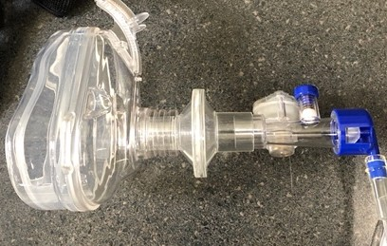
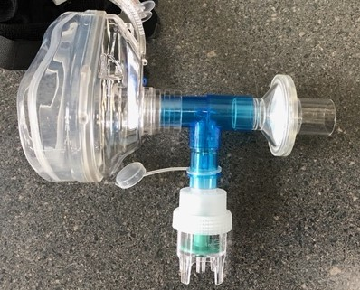
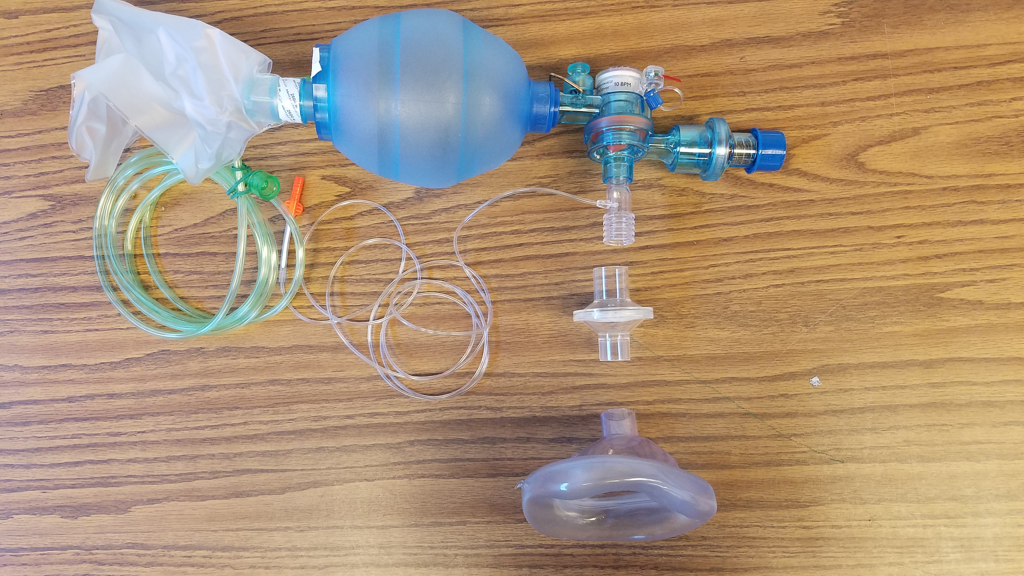
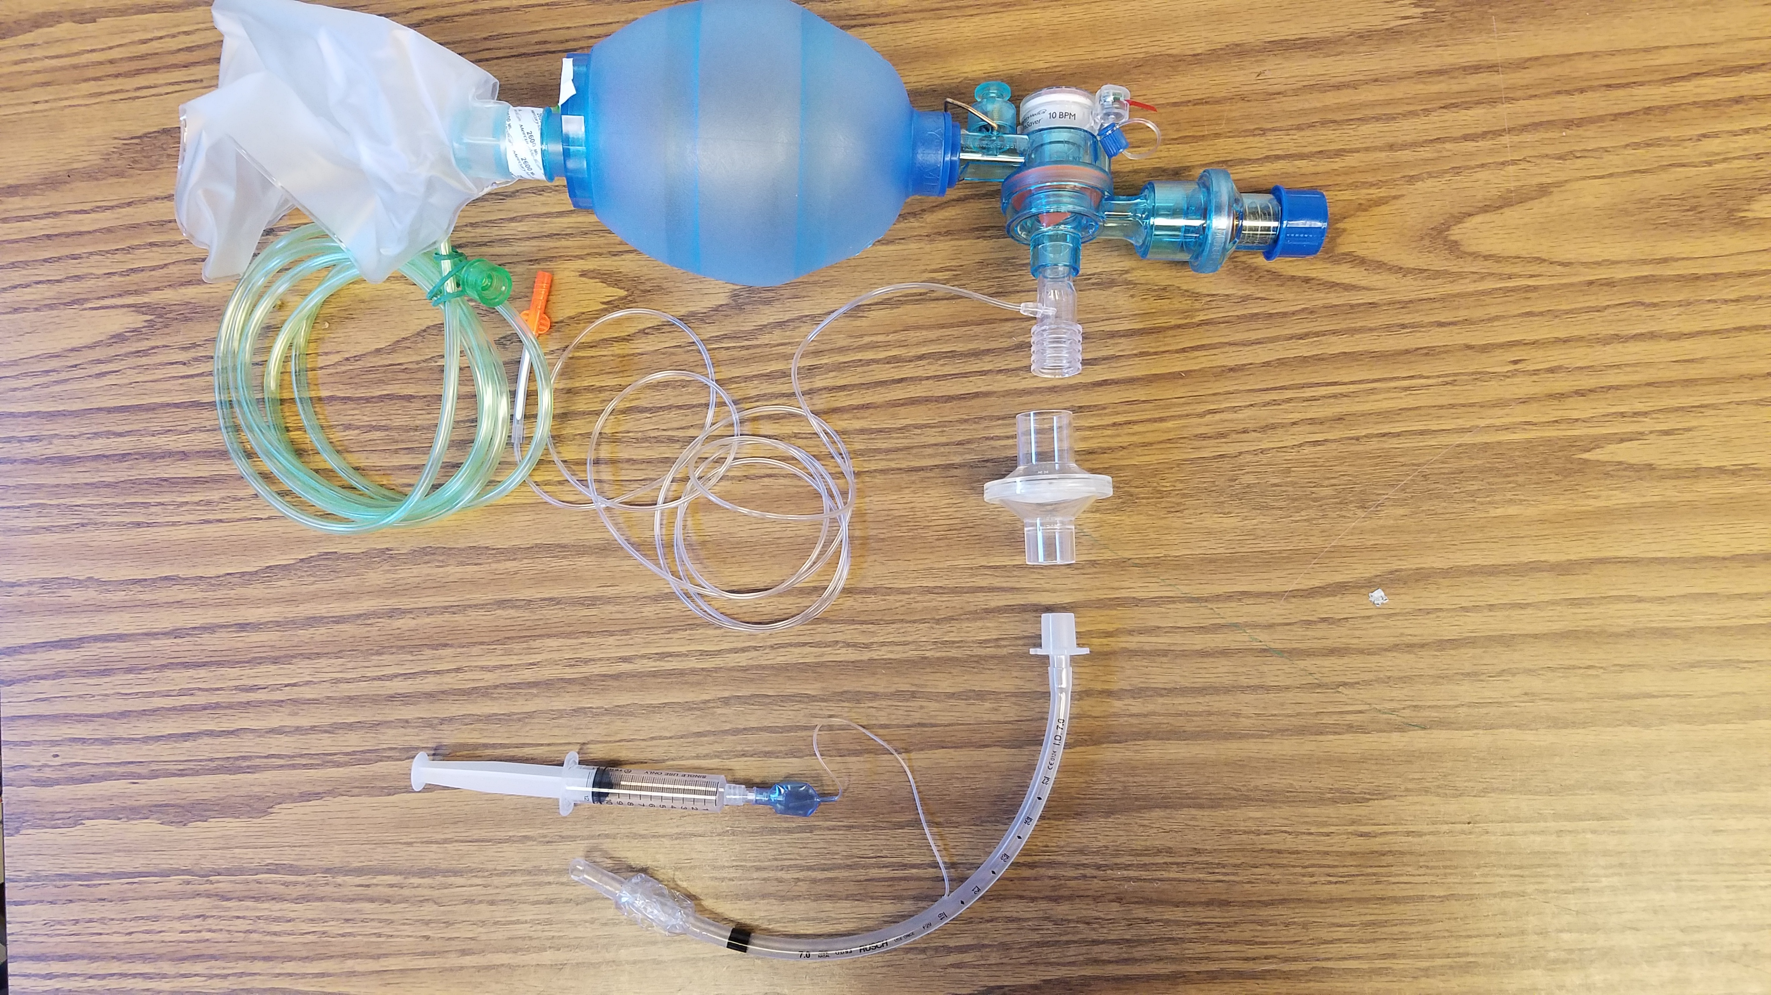
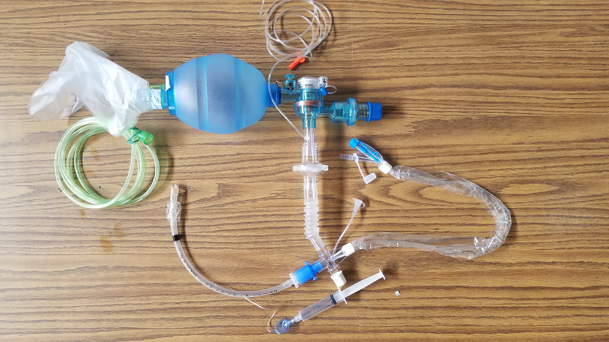
November 12 – 25, 2020
Subject to Change
COVID-19 Best Practices
Station & Crew Protective Measures
Crew Safety
EMS
Response & Transport
Aerosol Generating Procedures
O₂ & Airway
Hospital Notification
PPE
Decontamination
Crew Checklist: Transport Unit
Crew Checklist: Non-Transport Unit
PPE
Conservation
UV-C Decontamination
Force Protective Measures
Sick Personnel
BC Workflow
BC Algorithm
14 Day Monitoring
Daily Shift Monitoring
Oxygen Therapy and Advanced Airway Management
Aerosol Generating Procedure Precautions
If patient condition REQUIRES invasive airway intervention:
BVMs and CPAPs should be equipped with HEPA filters
FOLLOW STANDARD AIRWAY PROTOCOLS for patients needing advanced airway. Evidence shows our standard protocols safest for providers.
DO NOT USE VENTILATORS
Use CPAP and nebulized meds as last resort
Consider other appropriate treatments first
Maximize area ventilation: open doors/windows, use exhaust fans
Contact Medical Control for guidance, as needed
See decon checklists for specialized steps after aerosol procedures
Nasal Cannula
Place nasal cannula
Place surgical mask on face
CPAP
HEPA on mask
Non-Rebreather Mask
1. Place non-rebreather mask
2. Place surgical mask on top of
NRB mask
NEBULIZER
HEPA on end of T
BVM
HEPA between mask and BVM
ETT OR IGEL
HEPA between ETT or I-gel and BVM
BVM with Inline Suction
*Illustrations are examples only. Specific equipment may vary by agency.

Slide 6
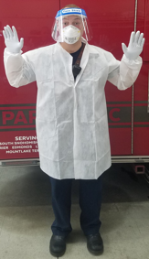
November 12 – 25, 2020
Subject to Change
COVID-19 Best Practices
Station & Crew Protective Measures
Crew Safety
EMS
Response & Transport
Aerosol Generating Procedures
O₂ & Airway
Hospital Notification
PPE
Decontamination
Crew Checklist: Transport Unit
Crew Checklist: Non-Transport Unit
PPE
Conservation
UV-C Decontamination
Force Protective Measures
Sick Personnel
BC Workflow
BC Algorithm
14 Day Monitoring
Daily Shift Monitoring
EMS: COVID-19 Hospital Notification Checklist
Does patient have COVID-19 symptoms?
Cough, Shortness of breath or Difficulty breathing
Fever, Chills or Muscle pain
Sore throat
New loss of taste or smell
GI symptoms – nausea, vomiting or diarrhea
Possible exposure to known or suspected COVID-19 patient
YES to ANY symptoms?
Notify hospital of a HIGH-Risk Isolation Patient
If NO to ALL:
Standard hospital notification
Upon arrival at Emergency Department:
Driver: register patient, coordinate with staff
Alert hospital of aerosol-generating procedures
Provider: Doors and windows open for ventilation
Consider keeping patient in rig until ready for transfer
Do not doff PPE until patient transfer
Don clean PPE for gurney decontamination
Doff gurney decon PPE prior to dressing clean gurney
Level III PPE (High Precaution)
N-95 Mask
Face shield or goggles
Gloves
Gown
Shoe covers optional
Donning Sequence MEGG
1. Mask 2. Eyes 3. Gown 4. Gloves
Doffing Sequence (reverse) GGEM

Slide 7
November 12 – 25, 2020
Subject to Change
COVID-19 Best Practices
Station & Crew Protective Measures
Crew Safety
EMS
Response & Transport
Aerosol Generating Procedures
O₂ & Airway
Hospital Notification
PPE
Decontamination
Crew Checklist: Transport Unit
Crew Checklist: Non-Transport Unit
PPE
Conservation
UV-C Decontamination
Force Protective Measures
Sick Personnel
BC Workflow
BC Algorithm
14 Day Monitoring
Daily Shift Monitoring
Crew DECON Checklist: Transport Unit
Actions if Aerosol Generating Procedures Performed on Suspected or Known COVID-19 Patient: *AFTER PATIENT TRANSFER/STILL AT HOSPITAL
Properly dispose of PPE, following PPE Re-use Practices
Wash hands
Allow patient compartment to air out with doors and windows open for 20 minutes
Deep clean apparatus while wearing PPE; face shield/goggles if spray/splash anticipated
Disinfect patient compartment with electrostatic sprayer per department procedure
Decon boots with spray CaviCide1
Decon goggles and wash with soap and water
Actions if NO Aerosol Generating Procedures Performed:
Properly dispose of PPE, following PPE Re-use Practices
Wash hands
Deep clean apparatus
Decon goggles, then wash with soap and water
Launder uniforms
Crews strongly encouraged to do a “Full Tyvek decon” after cardiac arrest, combative patient, or anytime crew has concerns for contamination.
AFTER AMBULANCE DECON:
Doff and bag uniforms
Clean hands
Don Tyvek suits
Place bagged uniforms in exterior compartment & return to station
Launder uniforms
Shower and don fresh uniforms
Crew DECON Checklist: Non-Transport Unit
ON SCENE DECON
Actions if crew had any patient contact:
*If unable to decon on scene, complete #1-3 outside station, not inside the bay. Then decon inside of rig wearing PPE.
Doff and bag all PPE
Clean hands
Decon boots with spray CaviCide1
Decon goggles and wash with soap and water
Launder uniforms
Decontamination notes:
Primarily use CaviCide1 spray for most surfaces, with a dwell time of 3 min.
CaviWipes1 should be used for electronic equipment. ie: Lifepack, tablet, phone.
Per CDC: “CaviCide1 has demonstrated effectiveness against viruses similar to SARS-CoV-2 on hard non-porous surfaces. Therefore, this product can be used against SARS-CoV-2 when used in accordance with the directions on hard, non-porous surfaces.”
Stryker Sidekick wipes are an acceptable alternative.
See Infection-Exposure Control Guidelines for further information.

Slide 8
November 12 – 25, 2020
Subject to Change
COVID-19 Best Practices
Station & Crew Protective Measures
Crew Safety
EMS
Response & Transport
Aerosol Generating Procedures
O₂ & Airway
Hospital Notification
PPE
Decontamination
Crew Checklist: Transport Unit
Crew Checklist: Non-Transport Unit
PPE
Conservation
UV-C Decontamination
Force Protective Measures
Sick Personnel
BC Workflow
BC Algorithm
14 Day Monitoring
Daily Shift Monitoring
PPE Conservation
Purpose
To continue to deliver the highest standard of care to our patients while conserving limited PPE inventory and continuing to reduce risk of exposure to EMS providers.
PPE Supply Conservation Practices
USE PPE SUPPLY CONSERVATION PRACTICES ON ALL EMS CALLS
NO non-essential personnel in hot zone
ONE crew member with current department level PPE conducts initial doorway triage
Additional crew members, also with current department level PPE, on stand-by outside of hot zone
Use minimum number of providers to safely treat and move patient
Mobilize additional personnel with current department level PPE based on circumstances and need
PPE Re-use Practices
N95 Respirator
N95 Respirator will be discarded after any of the below:
Respirator obviously contaminated, worn out, or soiled
Provider within 6 feet of patient during any aerosol-generating procedure
after 48 hours of re-use on shift
After 10 UV-C decontaminations (Two 5 minute cycles = 1 decon)
when fit or seal is compromised due to re-use
N95 Respirator will be re-used after either of the below:
Provider was never within 6 feet of patient (can re-use right away)
After UV-C decon procedure (FDA limits which N95s can be decontaminated with UV-each agency must verify eligibility)
Gowns and Face Shields
Shall be re-used until there is risk of contamination or show signs or wear
This includes gowns and/or face shields worn by stand-by personnel who did not have close contact with patient
Goggles
Shall be re-used after following recommended cleaning and decontamination

Slide 9
COVID-19 Best Practices
Station & Crew Protective Measures
Crew Safety
EMS
Response & Transport
Aerosol Generating Procedures
O₂ & Airway
Hospital Notification
PPE
Decontamination
Crew Checklist: Transport Unit
Crew Checklist: Non-Transport Unit
PPE
Conservation
UV-C Decontamination
Force Protective Measures
Sick Personnel
BC Workflow
BC Algorithm
14 Day Monitoring
Daily Shift Monitoring
November 12 – 25, 2020
Subject to Change
UV-C Decontamination of N95 Respirators
Per FDA, foldable respirators or with valves cannot be decontaminated by UV-C
Evaluate Respirator:
Obviously contaminated, showing wear, soiled?
Patient care (<6 feet) during Aerosol Generating Procedure?
Greater than 48 hours of re-use on shift?
10 UV-C decontaminations? (Two 5 minute cycles = 1 decon)
Fit or seal compromised?
YES
NO
Patient Contact?
Discard
NO
YES
Store in white bag
for next call
Store in brown bag for UV-C Decon
UV-C Decontamination Procedure
Visually inspect the respirator for obvious signs of wear and tear
Wear clean gloves to open the Lumin drawer
Place the N95 respirator concave side up on the acrylic rack
Lay straps away from N95 so there are no knots or tangles
Doff gloves
Close the drawer and press Start button
Wash hands or use sanitizer to avoid cross contamination
When 1st cycle ends, open drawer and flip respirator over
Lay straps away from N95 so there are no knots or tangles
Close drawer and press Start button for 2nd cycle
When 2nd cycle ends, remove N95 with clean hands
Mark N95 with sharpie to track decon cycles
Place in white paper bag with provider name
Decon exterior of UV-C box with CaviWipes1
Run Lumin through one cycle while empty to disinfect interior

Slide 10
November 12 – 25, 2020
Current Force Protective Measures*
Multicompany Training
Intra- or inter-agency multicompany training is suspended.
Station Access
Stations remain closed to the public, including general visitors and family members. Administrative staff, maintenance personnel or contractor station access is allowed with social distancing, face masks, and entry questionnaires. Deliveries to facilities should be on a no-contact basis. Blood pressure checks are suspended.
Administrative Offices:
All personnel should work in separate offices when possible to protect uniformed and non-uniformed staff.
Remote or rotating work is highly recommended for all uniformed and non-uniformed staff.
Air scrubbers/cleaners should be deployed in stations and offices if feasible.
Station Entry
Healthy-in/healthy-out procedures for all personnel to include temperature checks and questionnaire (completed for oncoming and off going personnel). Single station entry points.
Shift Change
Shift change should be conducted in such a manner to minimize the contact time between personnel.
Crews should not congregate together at shift change.
PPE Level
Required PPE Level for responses and station use is as identified in the current COVID-19 playbook.
Public Education/Special Events
Online preferred. In-person allowed with an identified infection mitigation plan in place.
Community Paramedicine
Remote/Telehealth without significant mitigating factors.
Fire Prevention
Commercial: Requested permit inspections allowed with all personnel in agency-mandated PPE. Existing building inspections (annual / company inspections) suspended unless conducted remotely (FaceTime, etc.).
Residential: Residential fire prevention activities suspended and are encouraged via virtual / remote applications only (FaceTime, Zoom, etc.). Refer smoke alarm installations and battery changes to gibbyhomefireprevention.org.
Uniforms/Station Wear
Agency specific T-shirts are recommended.
Station/Apparatus Cleaning
Maintain enhanced cleaning schedule and procedures.
Classroom Training
Consider suspension of non-essential congregate indoor training.
All participants in minimum of cloth face masks.
Maintain six feet of separation between all instructors and students.
Auxiliary Support Personnel
Auxiliary support personnel, including chaplains, are allowed to respond as long as the same level of PPE as regular response personnel is in place (including fit testing, as appropriate). Exposure control training as required.
*Adjustment of force protective measures is reliant on local conditions and is not tied any jurisdiction’s current phase.

Slide 11
November 12 – 25, 2020
Subject to Change
COVID-19 Best Practices
Station & Crew Protective Measures
Crew Safety
EMS
Response & Transport
Aerosol Generating Procedures
O₂ & Airway
Hospital Notification
PPE
Decontamination
Crew Checklist: Transport Unit
Crew Checklist: Non-Transport Unit
PPE
Conservation
UV-C Decontamination
Force Protective Measures
Sick Personnel
BC Workflow
BC Algorithm
14 Day Monitoring
Daily Shift Monitoring
BC: Sick Employee Workflow
Employee is sick:
Employee: Put on surgical mask, separate from crew
On Duty
Off Duty
Contact BC
Notify Captain
Contact BC
BC Complete: BC Sick Employee Algorithm
BC: Ensure On-duty Illness (OSHA 301) and ESO PCR completed on employee
Yes
COVID-19-like symptoms?
No
BC: Send employee home
(if on-duty) and roster as Sick Pending
BC: Send employee home
(if on-duty)
Employee should
follow home isolation guidelines
BC: Ensure immediate deep cleaning and disinfection of station occurs
Employee: Must Contact
MSO Keene 425.754.1740 or
MSO Ford 425.512.3974 or MSO Herbert 425.309.2766
Employee email: HR@southsnofire.org BC’s roster as sick employee
BC
MSO/HR
SCF MSO: Complete Illness Report Form
Everett Fire Department
MSO 425.257.7940
https://www.snohd.org/503/Drive-Thru-Testing-Available-by-Appointm
SCF MSO: Arrange Immediate COVID-19 Testing
King County:
https://redcap.iths.org/surveys/?s=84N479AHEE
Return to work 10 days from symptom start,
24 hours fever-free,
and symptoms resolved. Follow current department guidelines for RTW eligibility
SCF MSO: Update HR Tracking
UW Medicine:
https://www.uwmedicine.org/services/virtual-clinic
SCF MSO: Initiate exposure determination
investigation for crews (with possible close contact
with sick employee) and needed quarantine measures

Slide 12
COVID-19 Best Practices
Station & Crew Protective Measures
Crew Safety
EMS
Response & Transport
Aerosol Generating Procedures
O₂ & Airway
Hospital Notification
PPE
Decontamination
Crew Checklist: Transport Unit
Crew Checklist: Non-Transport Unit
PPE
Conservation
UV-C Decontamination
Force Protective Measures
Sick Personnel
BC Workflow
BC Algorithm
14 Day Monitoring
Daily Shift Monitoring
November 12 – 25, 2020
Subject to Change
BC: Sick Employee Algorithm
When any employee reports sick (On or Off duty), check the following:
Employee has:
Y
N
Fever
if “Yes”, what is it: _________
Any sign of respiratory illness (sore throat, congestion, etc.)
Cough
Shortness of breath/difficulty breathing
Fatigue or body aches
New loss of taste or smell
Nausea, vomiting or diarrhea
Recent contact with known COVID-19 positive person without wearing FULL PPE
If “Yes”, check who:
______ a patient
______ a family member, friend, co-worker, and/or other
If YES to ANY of the above:
Roster as: “Off, Sick-Pending” for next 10 days
Have the employee call one of the following MSO’s:
MSO Keene: 425.754.1740
MSO Ford: 425.512.3974
MSO Herbert: 425.309.2766
If for some reason MSO is not available, you may alternately call Laurie DeLeon 425.551.1274 or Sandra Hollenbeck 425.309.5157.
Employee MUST talk to one of the MSOs so that proper screening and testing arrangements can be made as soon as possible.
If NO to ALL of the above:
Roster as: “Sick-Employee”
Email: hr@southsnofire.org with:
Employee name
Date of sick call

Slide 13
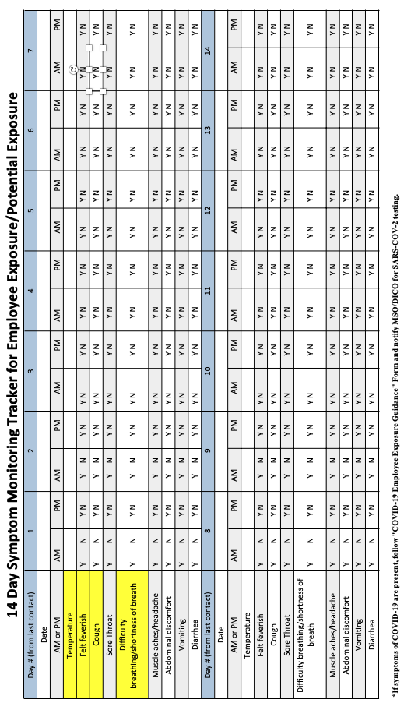
November 12 – 25, 2020
Subject to Change
COVID-19 Best Practices
Station & Crew Protective Measures
Crew Safety
EMS
Response & Transport
Aerosol Generating Procedures
O₂ & Airway
Hospital Notification
PPE
Decontamination
Crew Checklist: Transport Unit
Crew Checklist: Non-Transport Unit
PPE
Conservation
UV-C Decontamination
Force Protective Measures
Sick Personnel
BC Workflow
BC Algorithm
14 Day Monitoring
Daily Shift Monitoring
14 Day Symptom Monitoring: Employee Exposure

Slide 14
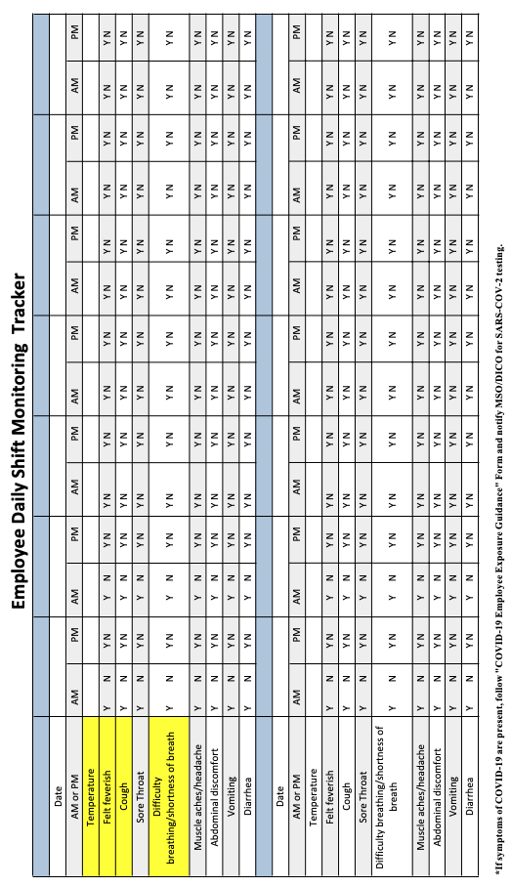
COVID-19 Best Practices
Station & Crew Protective Measures
Crew Safety
EMS
Response & Transport
Aerosol Generating Procedures
O₂ & Airway
Hospital Notification
PPE
Decontamination
Crew Checklist: Transport Unit
Crew Checklist: Non-Transport Unit
PPE
Conservation
UV-C Decontamination
Force Protective Measures
Sick Personnel
BC Workflow
BC Algorithm
14 Day Monitoring
Daily Shift Monitoring
November 12 – 25, 2020
Subject to Change
Daily Shift Monitoring

